Slide 1
Fantastic
Mr. Fox
Dominic
PLOT & Sequence-Novel Study

Slide 2
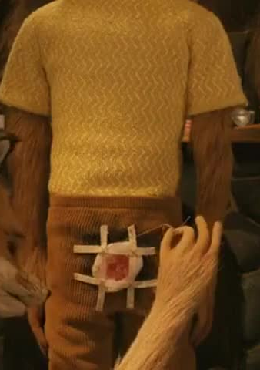
PLOT & Sequence
After reading with your group, work out the answers for the following questions.
What happened to Mr. Fox's tail? Can you find the original evidence from the book to proof?
Your answer:Farmer Bean shot Mr. fox tail and Mr. fox ran away back to his house.

Slide 3
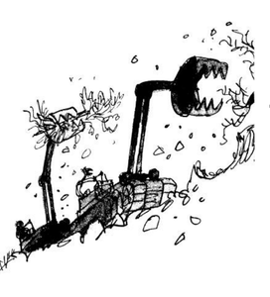
PLOT & Sequence
After reading with your group, work out the answers for the following questions.
What is shovels? And why did the farmers stop using shovels?
Your answer: A shovel is something to dig to like plant or find treasure. It because the shovel was to slow and Mr. fox family dug deeper.

Slide 4
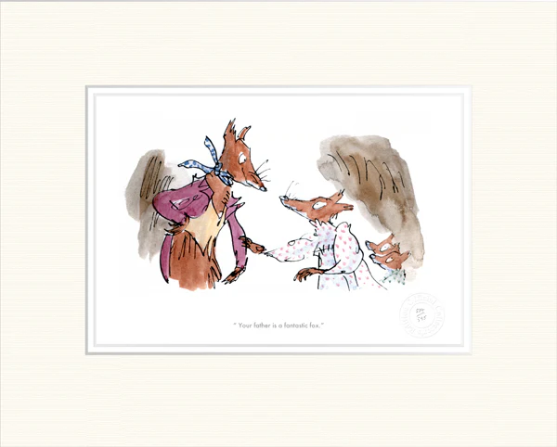
PLOT & Sequence
After reading with your group, work out the answers for the following questions.
How did the foxes feel when they heard the machines?
Your answer:They feel terrified of the loud noise.

Slide 5
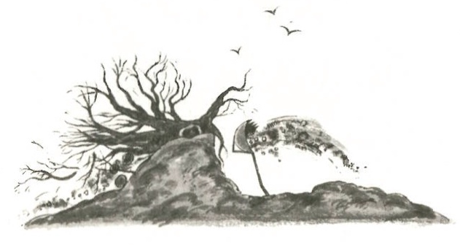
PLOT & Sequence
After reading with your group, work out the answers for the following questions.
What did the hill look like at the end of Chapter 4? Describe it by using your own imagination
Your answer: It look like nothing was there like a meteorite destroy everything.

Slide 6
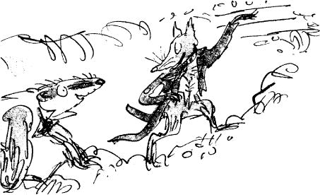
PLOT & Sequence
After reading with your group, work out the answers for the following questions.
Where did the foxes find safety? Do you agree it is a safe place for foxes? Why or why not?
Your answer:Another tunnel that they dug. Yes because excavator can't dig that deep but only shovel can if you have the strength you will able to do it.

Slide 7
Summarise your reading
Write a summary of the "Best Part" of the chase in 4 bullet points.
Examples:
The Surprise Attack: The story gets exciting when the three farmers hide behind a tree and shoot at Mr. Fox, but they only manage to shoot off his tail!
The Shovel Race: The farmers start digging with shovels to catch the foxes, but Mr. Fox tells his family, "Dig for your lives!", and they dig a tunnel so deep that the farmers can't reach them.
The Mechanical Monsters: The farmers get angry and bring in two giant yellow tractors to dig up the whole hill, making a loud "clatter-clatter" sound.
The Narrow Escape: Even though the machines were fast, the foxes worked together and stayed just inches ahead of the shovels until they reached safety deep underground.
The shovel race: The farmers are annoyed because of Mr. fox he was to clever and careful of going outside.
So the 3 farmers had enough they use a big tractor to dig out the fox family.
But the fox family can dig faster than a man so they dig and dig until the farmers can't dig anymore.

Slide 8
Publish a news on Newspaper!-Link
Writing: Write a "Breaking News" report about the farmers destroying the hill.
Features of a Newspaper
Headline – usually only a few words. It tries to attract the attention of the reader by telling
them briefly what the story is about.
By author– who wrote the article
Introduction (orientation)– summarises the main points of the article (the 5 Ws)
Identify the 5 Ws
When did the incident/event happen?
Who is the article about?
What happened?
Where did the incident/event happen?
Why did it happen? or Why would the reader be interested?
Photographs and captions – images with an explanatory sentence.
Describe what images and captions your article has included.
Perspective: Remember, a forest newspaper would think the farmers are the "Bad Guys"!
By Ms Song the Owl
Yesterday afternoon , the local Fox family narrowly escaped a terrifying attack by two giant mechanical monsters on the High Hill . The machines were brought in by three angry farmers because they wanted to catch the foxes once and for all.
The quiet of the valley was broken by a "clatter-clatter" sound as Farmers Boggis, Bunce, and Bean drove giant tractors up the slope. Witnesses say the machines began "biting" great chunks out of the hill. Mr. Fox and his family had to dig faster than they ever have before to stay ahead of the sharp metal shovels.
"It was a miracle," said one local rabbit. "The foxes stayed just inches ahead of the blades. Now, there is a giant hole where the hill used to be!"
THE DAILY NEWS

Slide 9
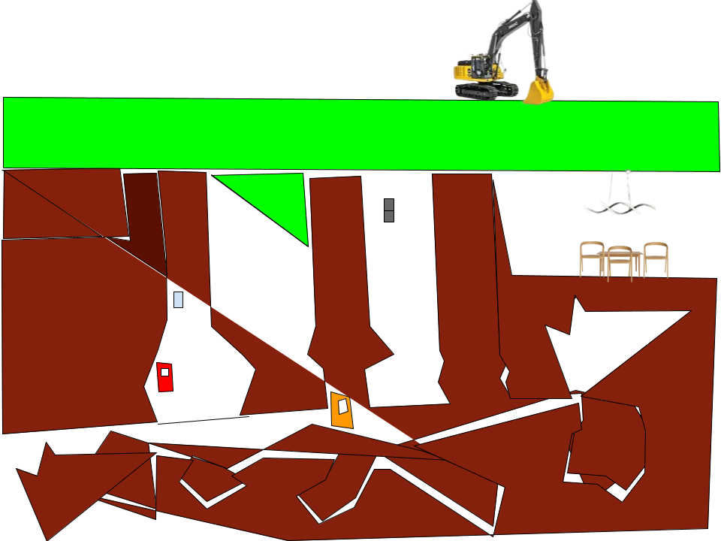
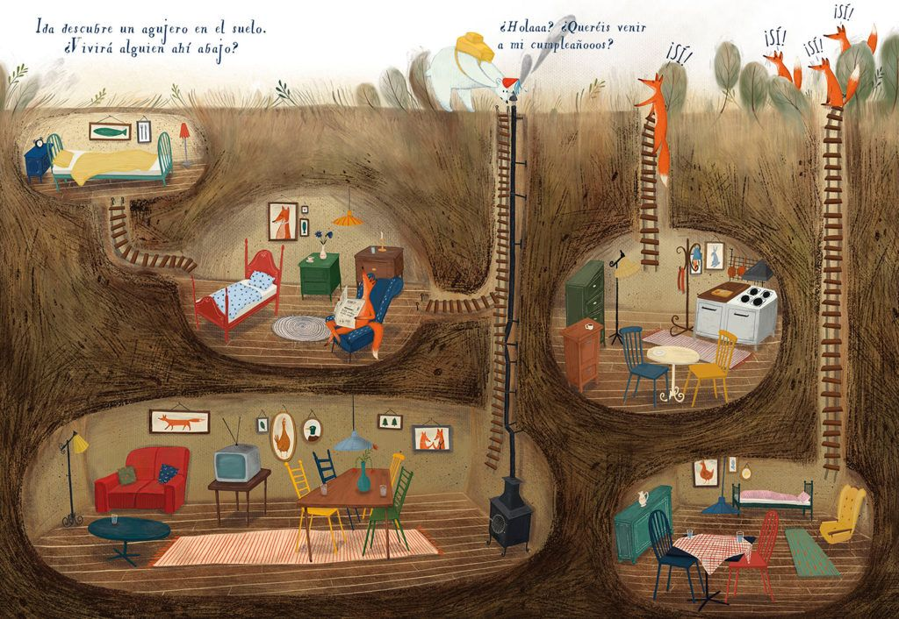
Creative Task
Draw on paper or in google drawing to help Mr Fox to build a ‘Tunnel map’ showing the path the foxes dug to escape.

Slide 10
Research Project
Look up how fast a real fox can dig compared to a human with a shovel.

